Slide 1
BBM412 COMputer graphıcs FINAL PROJECT SKYSOCCER 2020
Kerem Üremez-21627782
Kaan Nuri Beyhan-21627026
Neşe Gamze Uyanık-21627744

Slide 2
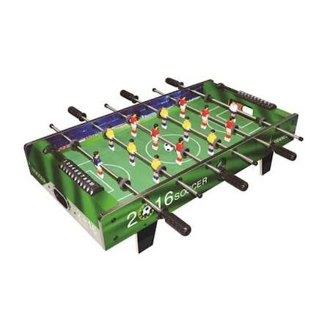
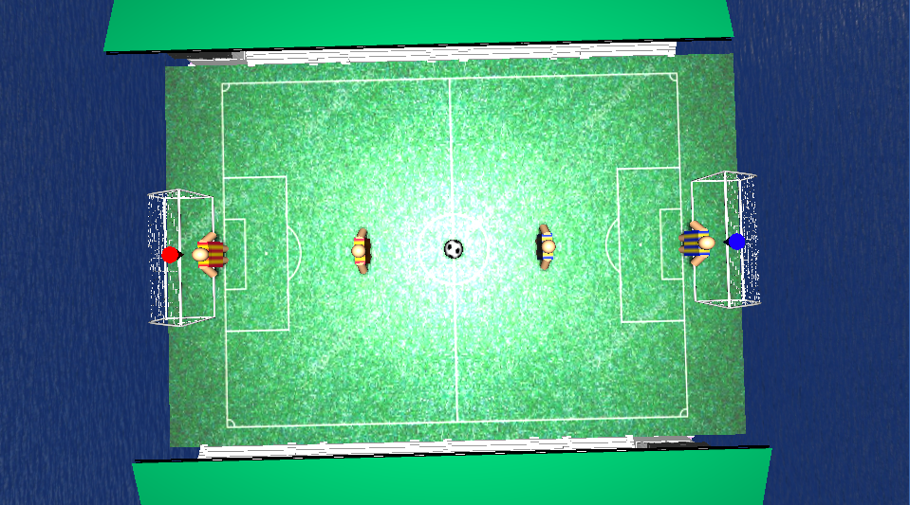
PROPOSAL
Firstly we planned to make a game like a pinball in the proposal but as we progressed through the project, we decided to turn our project into a football game to increase the variety of the gameplay.

Slide 3

STARTING OF PROJECT
Before programming to the game, we research a lot of basic games to understand how to program a game. After that, we try to learn to use the THREE.js library. As you know, THREE.js allows us to create a scene, objects, camera and light easily.

Slide 4
General Game Play
Two users can play our game mutually. Each user can change their uniforms by choosing the team they want. Each team has 2 players. When playing the game, you can switch between these players. The player who reaches 5 goals wins the game.

Slide 5
General game play (cont.)
Users can move players with keyboard keys. There are also 2 extra features that players can use. They can pass to teammate or shoot. The player can orient ball in different directions when shooting. Action is related to which side of the player touches the ball.

Slide 6
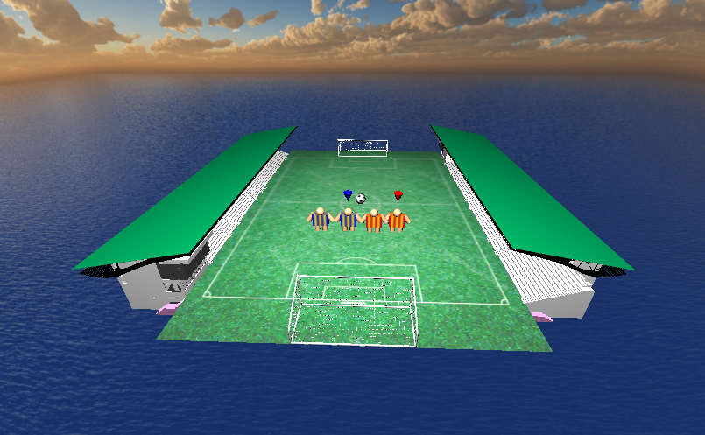
Inıt Function
To begin with, we made all our definitions in the init function. We created a camera and scene with Three.js. After that, we created materials for objects. We won’t mention all of these materials. But we want to refer that some of the materials are used for uniforms. This means that when you select a different team, players' uniforms change according to these selections. After that, we created some objects like a ball, players and planes.

Slide 7
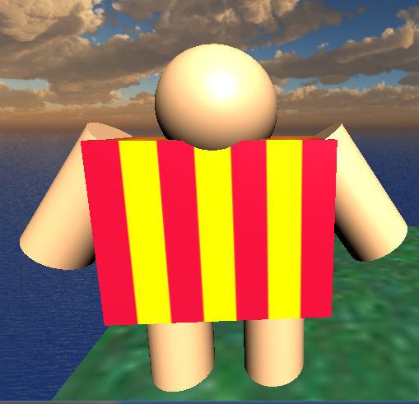
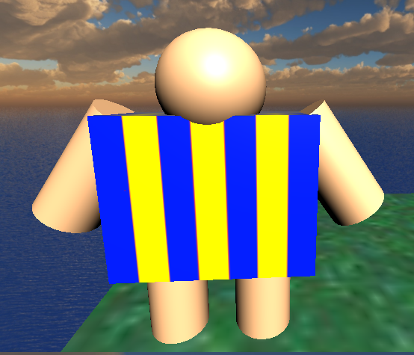
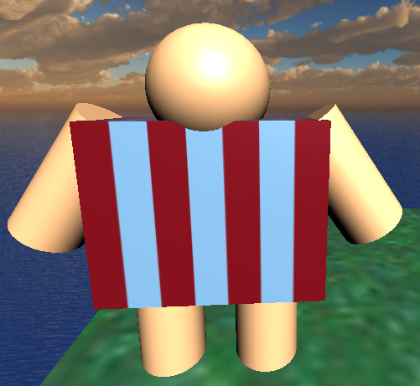
Player’s design
When we started to design our players, we preferred these players to be a combination of the objects we created. So we created the player figures ourselves with geometric shapes. To do that we created a sphere for their head, a square for their body, four-cylinder for their arms and legs.

Slide 8
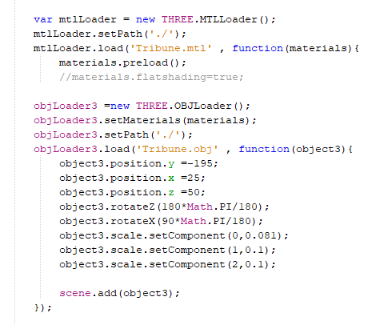
In this init function, we get our tribune and goals from the sites we mentioned in the references, uploaded them as objects and positioned them with using THREE.js library.
To include these objects, we set path first. After that load objects and materials.
In this code, we set our materials with MTLLoader and get objects via OBJLoader.

Slide 9
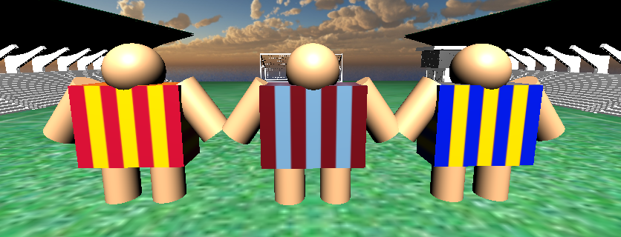
Createformas
In this function, we get inputs by buttons on the screen. When you clicked the button, the uniforms of players are changed. To do that, we change our materials. Also when you select a team that is different from your initial team, we must rearrange goal lights that are animated after a making score. Because we use different lights for different teams.

Slide 10

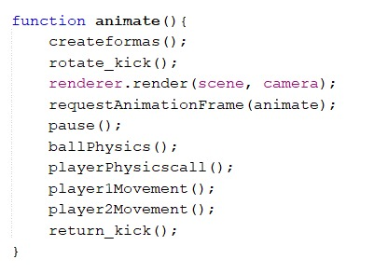
ANIMATE
After these definitions we have a animate function which is a recursion. We call all other functions in this function.

Slide 11
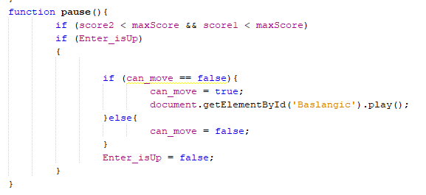
Pause optıon
We have a pause option in our game. Our Pause function first checks whether there is a winner. After that, it checks ‘Enter’ is down. If enter is pushed, then our can_move variable changes and most of the functions check whether can_move variable equals true or not. So when you pushed enter, the game stops.

Slide 12
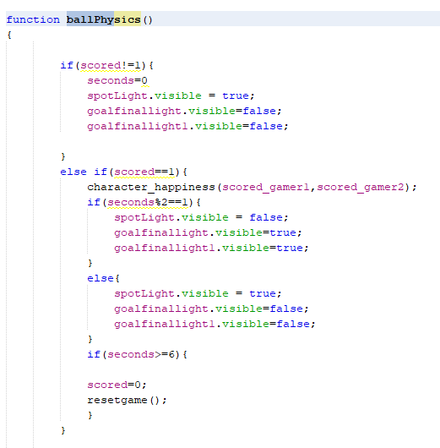
ballPhysics
First of all, we check whether one team is scored a goal or not. If there isn’t scored a goal, we set seconds variable to zero and turn off the lights which are used for animation after making a score. Then set our spotlight to visible.
If the score is made, then we turn on goal lights and turn off our spotlight. After one second, the spotlight is on and goal lights are off. The animation continues like that sequentially. Additionally, we call the character_happiness function.
Lastly, if our seconds variable is greater than six seconds, we set scored variable to zero and reset game.

Slide 13
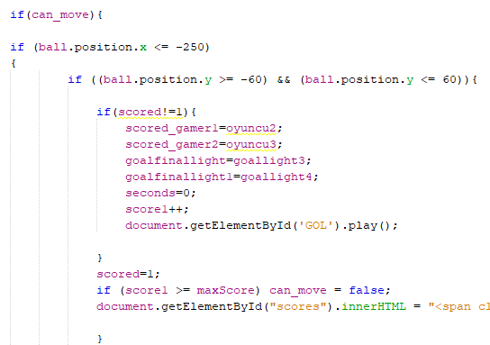
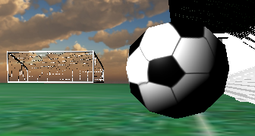
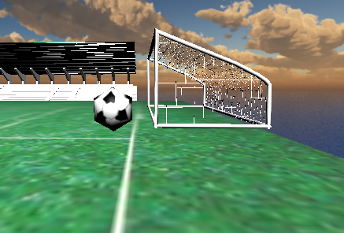
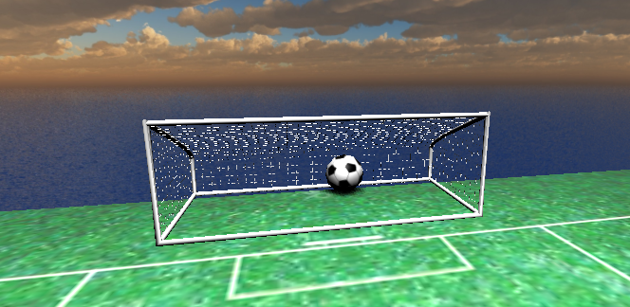
In this part of the algorithm, firstly we check whether the ball enters goal area or not. If the ball is inside of a goal, then we arrange lights animation. After that opposite team score is increased and the goal sound effect is played. Lastly, we check the score if it’s equal to maxScore then the game is over.
The algorithm continues by checking whether the ball position is in the goal area. If so when the ball hits borders of goal, we change its direction and rotation to opposite direction and rotation. For instance, the ball hits the right border of the goal. Then we only change the x-axis of direction and rotation.
After that, we do the same things for all borders of the playground.

Slide 14
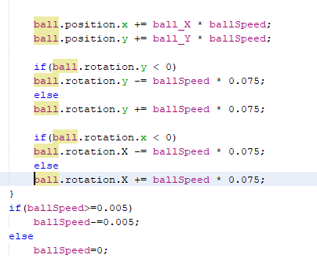
We calculate the multiplication of ballSpeed and ballDirection to assign new positions to our ball. We do the same operations for rotation calculation.
BallSpeed is decreased in every function call. If players don’t touch the ball for a while, the ball stops.
In conclusion, this part of the algorithm, rearrange ball rotation, ball speed and ball location in every call.

Slide 15
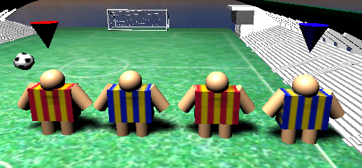
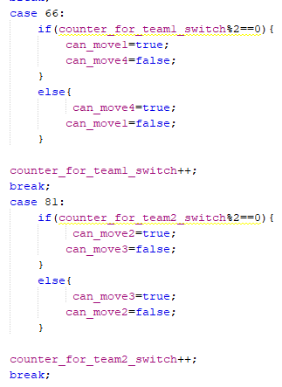
We created cones in our init function. We used it to determine which player is under control. Each team has a different cone material. So if you change the team, the texture of cones is changed. You can switch between players with ‘B’ key for the first team or by ‘Q’ key for the second team.
We have two variables. We increase the variable by 1 for every ‘Q’ or ‘B’ is pushed. We have a mod algorithm and four different variables to specify which player is under control. Depending on these codes, their values are changed and we can control the player whose value is true.

Slide 16
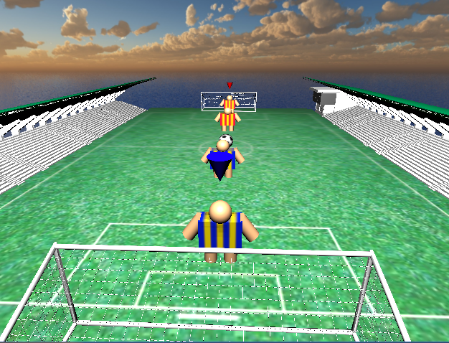
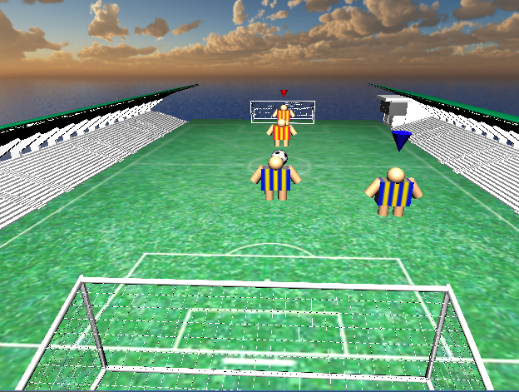
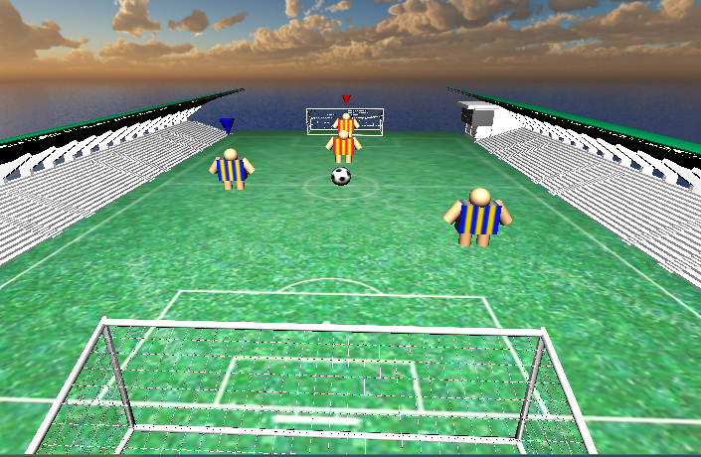

Slide 17
playermovement
As I mention in the previous slide, we have four variables to choose which player is under control. Two of them for the first team and rest for other team. Let’s consider the first team for this function. If our move1 variable is true, then player1 can be controllable. Cone for team1 positions set to player1 positions. You can move your player via arrow keys unless you want to go outside of court. When the user presses the arrow buttons, the algorithm checks whether the player can go there or not.
If our result is false then the player’s positions remain the same.
Else we increase or decrease position x or position y depends on the direction.

Slide 18
PLAYER physıcs
In this function we specify the ball speed, direction and rotation. When you direct the ball, it’s important that which side of player touches the ball and ball speed depends on whether the player shoots or not.

Slide 19
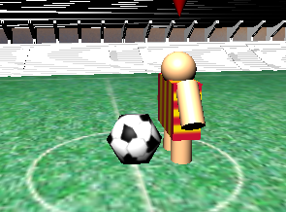
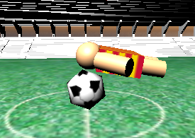
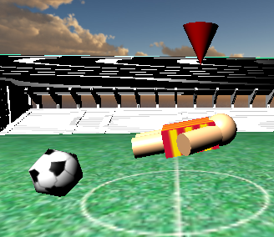
Beginning of the function, we set a variable to the width of the player. we check whether a player shoots or not. If the player shoots or passes, then we change our variable. Because the player may touch earlier while hitting the ball than when he did not hit the ball. Let’s go in detail in our code.

Slide 20
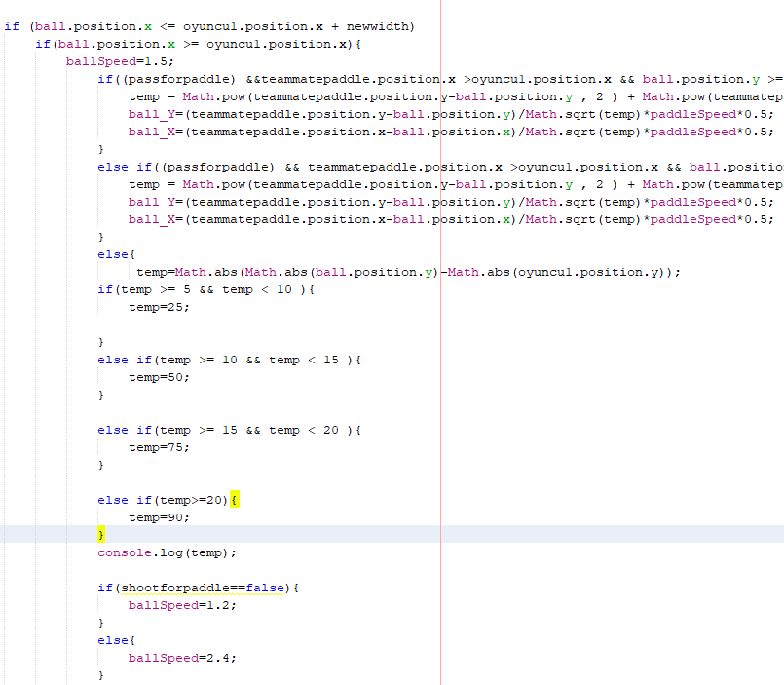
To begin with, we check if the ball touches the player. We control both x and y-direction. While this checking, we use a variable that we talk on the previous slide. After that, we assign a value to ball speed.
Pass:
Then we check whether the passkey is pushed or not. Let’s say it’s pushed and the teammate stands front. Then we check if the ball touched the front side of the player, then we use some math function.

Slide 21
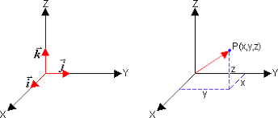
Firstly we calculate a distance between player to player both on x-axis and y-axis. After that we convert this to unit vector. We multiply this vector with player speed and finally adding them to ball direction x and y.

Slide 22
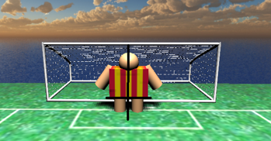
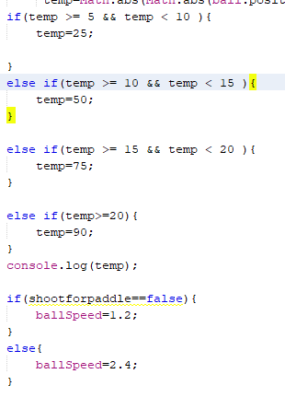
Shoot:
If the player doesn’t pass then we subtract ball position from the player position and take the absolute value of this result. We check this distance in which interval. After checking it, we create an angle. Then we check if the player pushed the ‘Space’ key which is shot key for the first team. If the result is true, then assign ballspeed to a higher value. If not, we assign a lower value.

Slide 23
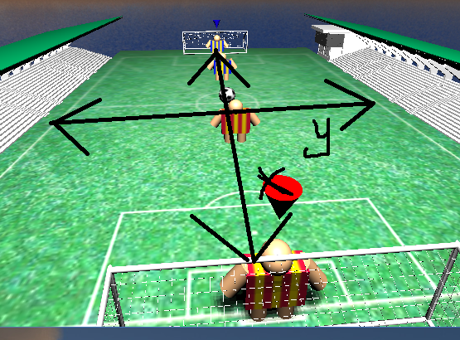
We go on with determining which side of the player touches the ball. If the middle of the player touches, then the ball must move straight forward. To do that we assign player speed to ball_x direction and 0 to ball_y direction.
If the right side of the player touches the ball, then we calculate ball_y direction with the sin of angle multiplied by player speed. We can find our ball_x direction with cos of angle multiplied by player speed.
Lastly, we do the same things for the left and backside of the player.

Slide 24
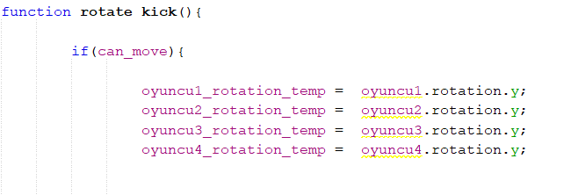
Rotate_kıck and return_kıck
We have two functions which are rotate_kick and return_kick. These are used for players hitting.
Firstly in the rotate_kick, we kept the players positions in the variables before hitting.

Slide 25
Rotate_kıck
After checking the keyboard operations, we enable the player to perform the kick movement on the y axis. We determine the direction of rotation by checking the side where the ball come from. Apart from just hitting, we also added the ability to pass to his teammate.

Slide 26
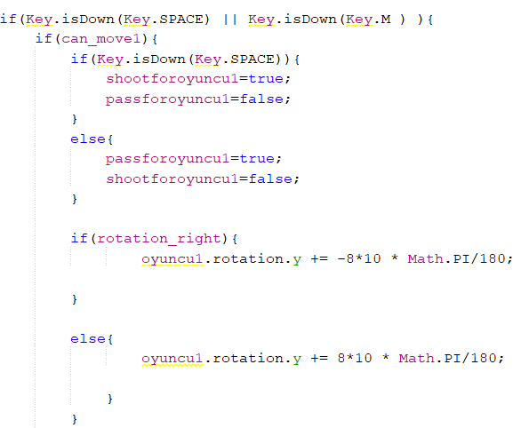
For example, when the user presses the space key to hit the ball and control is in the first player, we rotate the first player by the value specified on the y axis.In other case, user can press m to pass his own player.

Slide 27
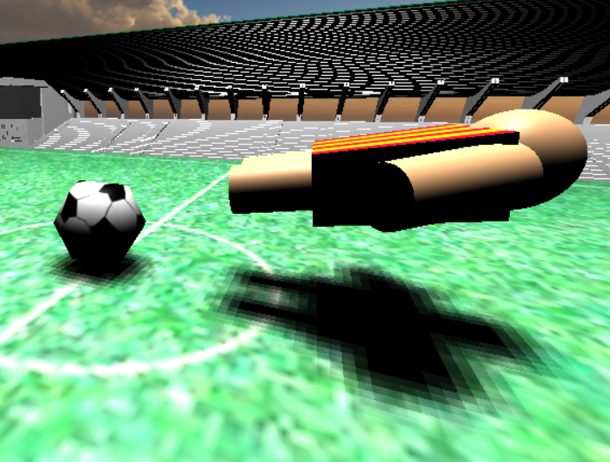
The player comes to this position after making the hit action

Slide 28
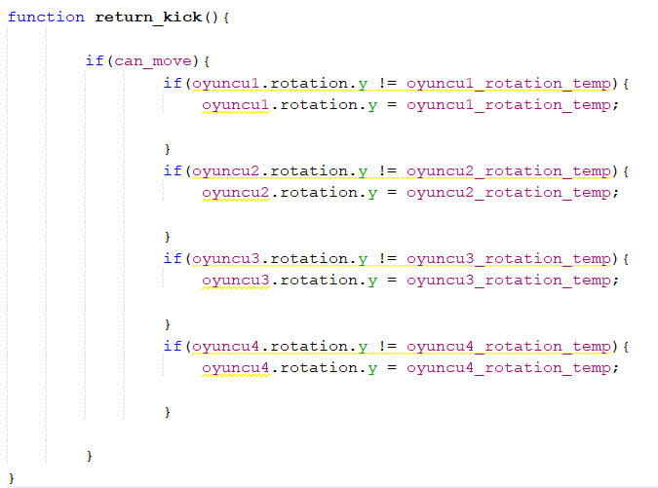
Return_kıck
After all these controls and render the scene. We call return_kıck function to return the player to the initial position. We control whether the player is making a kick movement and if it does, reset his position.

Slide 29
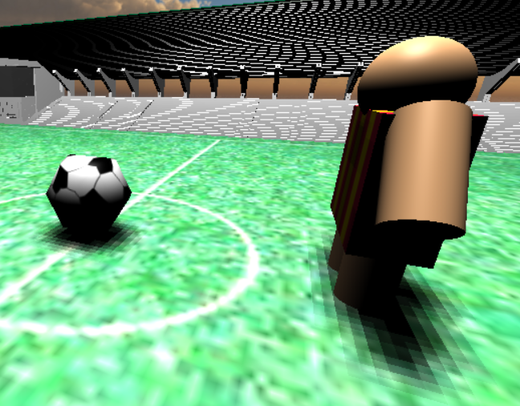
After calling the return_kick() function, the player returns to its initial position.

Slide 30
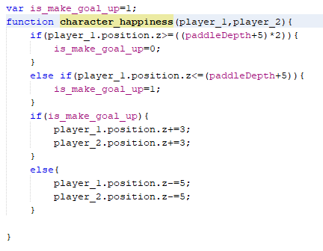
Character_Happiness
In this function, we make a basic animation. This function is called following a score and players who make a score, start to jump by this function.
Algorithm:
We have a control variable for this function. It provides that player’s moving direction on Z-axis. We specified boundary values for this jumping animation. If the player position on z-axis greater or less than this values our control variable is changed by the algorithm. Lastly according to this control variable player moving up or down.

Slide 31
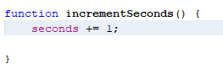
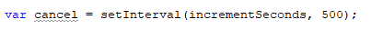
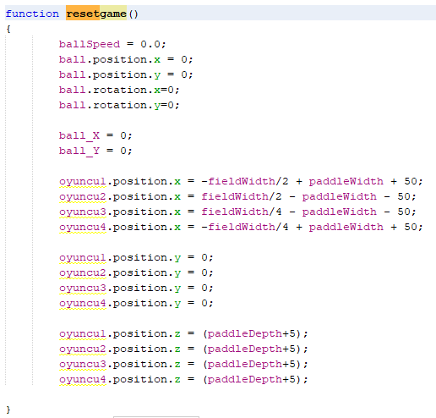
clock
We created a clock to specify time. We measure time whenever a team makes score. According to time, we move light and player animation. Animation plays for six seconds. After animation is played, we set seconds variable to zero.
RESETGAME()
This function resets ball speed, direction and rotation. Then it relocates players to starting position. We use this function when a team makes score.

Slide 32
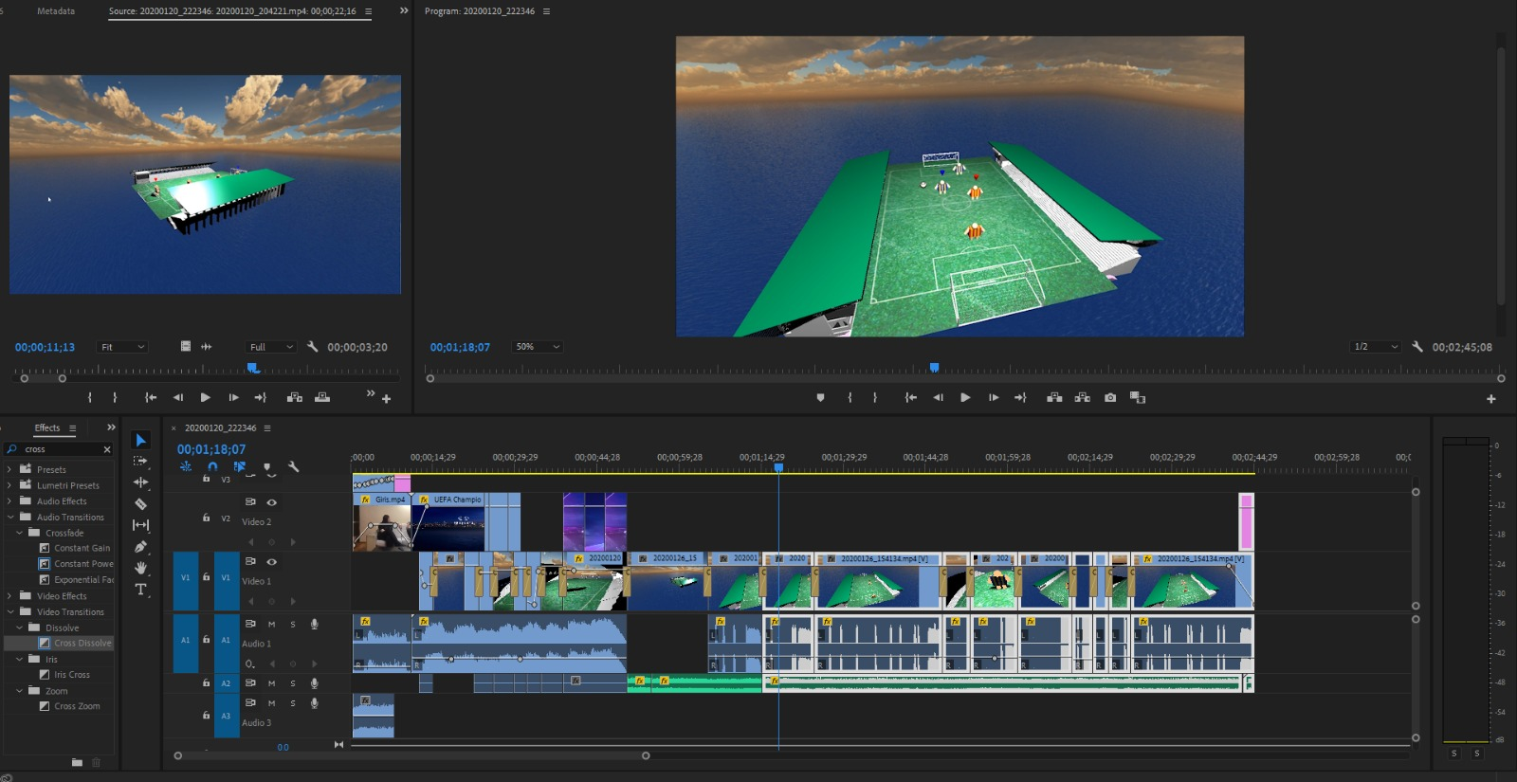
Recording and Edıtıng vıdeo
We use two programs while recording and editing the video. These are:
ADOBE Premiere Pro CC 2019
Apowersoft Online Screen Recorder

Slide 33
INPUT OPTION
Gameplay:
Player movement : Arrow keys for team1 W-A-S-D for team2
Switching player : ‘B’ key for team1 ‘Q’ key for team2
Pass : ‘M’ key for team1 ‘X’ key for team2
Shoot : ‘SPACE’ key for team1 ‘K’ key for team2
Camera:
You can move and rotate the camera with mouse.
Light:
You can move spotlight with 1-2 on x-direction, 4-5 on y-direction, 7-8 for z-direction.
Shading option:
You can switch shadings with ‘L’ key between smooth shading and flat shading.

Slide 34
References
https://archive3d.net/?a=download&id=b6be294f
https://free3d.com/3d-model/football-goal-473670.html
https://threejs.org/docs/
https://github.com/amingholami/WebGL-Foosball
https://www.youtube.com/watch?v=X3Zs-HZczUM
https://www.youtube.com/watch?v=rTCMKasiSsU&t=1281s
https://www.youtube.com/watch?v=qT8M5nrLoL8
https://www.youtube.com/watch?v=-FLgShtdxQ8&t=1319s
https://www.youtube.com/watch?v=6HDDjHEKfn0
https://www.google.com/search?q=lang%C4%B1rt+oyunu&tbm=isch&ved=2ahUKEwiUs8jv0Z7nAhUQmbQKHTDHBAQQ2-cCegQIABAA&oq=lang%C4%B1rt+oyunu&gs_l=img.3..0l4j0i5i30l2j0i24l4.1200936.1202804..1203055...0.0..0.243.1878.0j12j1......0....1..gws-wiz-img.......0i67j0i131.v_MF1u3omZA&ei=aiUsXpTWNZCy0gWwjpMg#imgrc=_BzqkI457gN3tM
https://minetest.daconcepts.com/my-main-mod-archive/sofars_mods/skybox/textures/

